Slide 1

Project «QiVita - A smart glove and a bracelet measuring electropuncture and pulse diagnostics and sending the diagnosis of a person to an application on a smartphone»
Kazakhstan Almaty

Slide 2
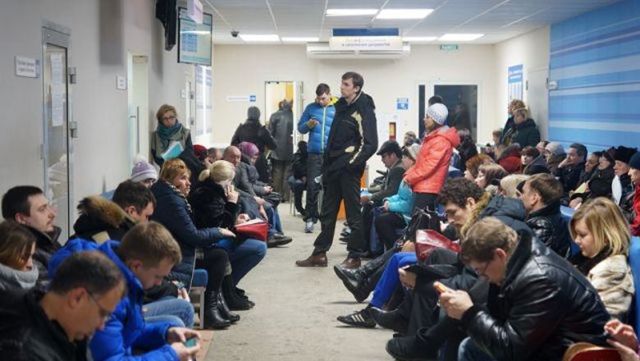

Queues in polyclinics

Slide 3
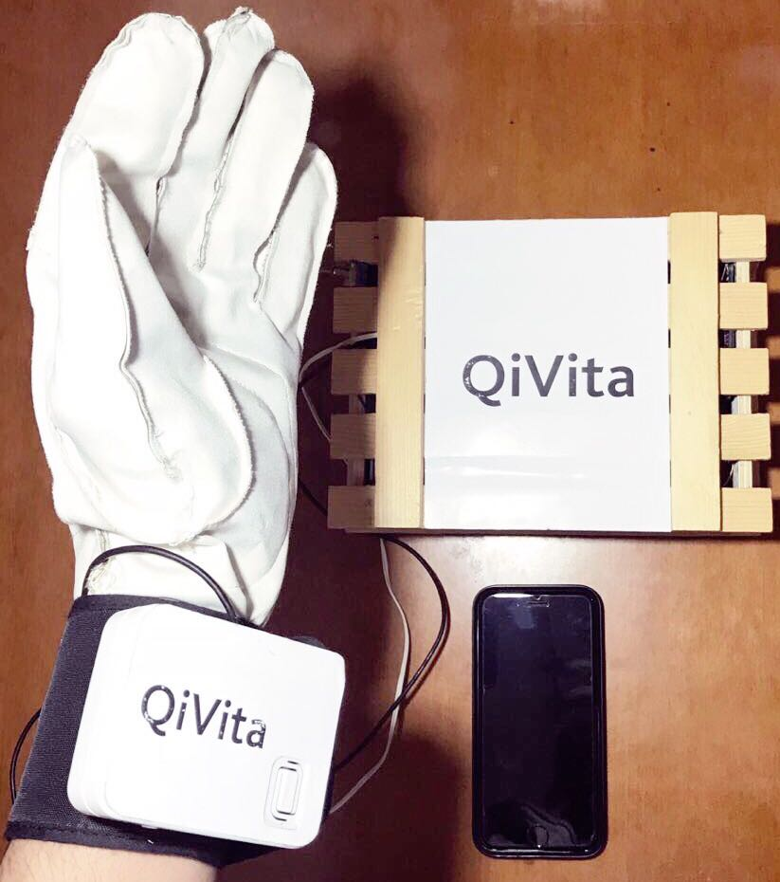
Our solution

Slide 4
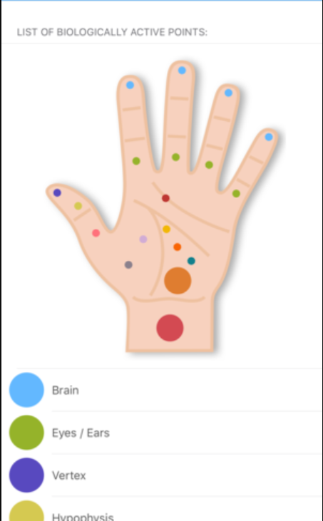
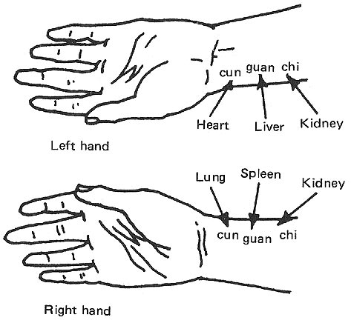
Foll Method
Pulse diagnostics
Diseases that device can detect:
Arrhythmia
Gastritis
Bronchitis
Pancreatitis
Intracranial pressure
Low and high blood pressure

Slide 5




Future plans

Slide 6

Let's make life easier!

